Slide 1
Present Simple and Present Continuous

Slide 2
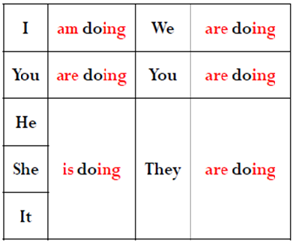
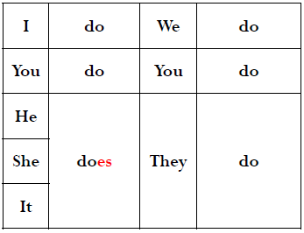
¿Cómo formamos los tiempos?

Slide 3
Why are you working today, Stew. People don’t usually work on Sundays.
I know that Tom but I’m flying to Africa next week, so I want to get more money.

Slide 4
1. for permanent situations
John works in a bank.
They love coffee.
They have two children.
I don't like swimming.

Slide 5
2. for habits and routines with the adverbs:
always, often, usually, sometimes, never
I often play hockey .
They usually watch TV in the evening.
I sometimes go to work by car.
I never do morning exercises. And you?

Slide 6
3. with the adverbs: every day, once a week,
every year, four times a month, at the weekend
She goes swimming at the weekends.
Sam takes a shower every day.
I blow out candles once a year.

Slide 7
4. for facts and things that are generally true.
It snows in winter.
Water boils at 100°C.
Plants die without water.

Slide 8
5. for programs and timetables
Our lessons start at 9 o’clock.
The football match starts at 8 p.m.
The train leaves at 7.30.

Slide 9
EJEMPLO
Bob lives in a small flat in London. In the mornings, he wakes up and has a shower. Then he makes breakfast. He usually has a typical English breakfast with eggs and bacon. After that, he goes to work.
He works in an office in the center of London. He sits in front of the computer all day and writes emails. He doesn’t like his job very much, but he likes earning money. At 12 o’clock he goes to lunch and has a sandwich. After lunch, he comes back to work and writes more emails. At 5 o’clock he leaves work.
He sometimes sees his girlfriend in the evenings. She lives on the opposite side of London, so he takes the Underground.
On weekends, he doesn’t have to work. He usually goes out for a few beers with his friends on Friday night. On Saturday he goes shopping. On Sunday he goes to his grandmother’s house for tea.
On Monday he gets up early and goes back to work.

Slide 10
ACTIVIDAD
En grupos cread un texto utilizando exclusivamente el present simple.
Guiaos a partir de los siguientes verbos y expresiones:
Verbos: Go, wake up, have/take a shower, have breakfast- lunch-dinner, like, want, believe, write, go to work, leave…
Expresiones: usually, sometimes, hardly ever,twice a week, once a month, everyday, often…

Slide 11
E
Answer the questions about your day.
What time do you usually wake up?
What do you normally have for breakfast?
Do you usually have lunch at home?
What do you do after school?
What do you usually do in the evenings?

Slide 12
Verbos que no usan Present Continuous
Existen una serie de verbos que normalmente no pueden emplearse en Presente Continuo, excepto en ocasiones excepcionales:
Verbos que expresan sensaciones, como feel (sentir), hear (oír), see (ver) o smell (oler).
Verbos que expresan posesión, como belong (pertenecer), own (ser propietario de) o possess (poseer).
Verbos que expresan sentimientos o emociones, como desire (anhelar), detest (detestar), dislike (disgustar), fear (temer), hate (odiar), like(gustar), love (amar), respect (reºsp`+<petar), want (querer) o wish (desear), h.
Verbos que expresan actividades mentales, como agree (estar de acuerdo), believe (creer), forget (olvidar), know (saber), realice (darse cuenta), recognize (reconocer), remember (recordar), suppose (suponer), think (pensar) o understand (entender).

Slide 13
1: for things that are happening at the moment of speaking.
I’m working at the moment.
Please call back – we are eating dinner.
Julie is sleeping.

Slide 14
2. for temporary situations, when we feel
something won't continue for a long time.
She’s staying with her friend these days.
I’m reading a really great book.
John’s working in a bar until he finds a job in his field.

Slide 15
3. with always and constantly to show our annoyance,
anger and criticism
He is always losing his keys!
You are always telling the lies.
He is constantly using my computer when I need it!.
They’re always being late.

Slide 16
4. for definite future arrangements (with a future time word).
We have already made a plan and we are sure that the event will happen in the future.
He is flying to Jamaica tomorrow.
We’re going to the beach at the weekend.
They’re coming to the party in three days.

Slide 17
Ejemplo Present Continuous
Monica is an accountant. She works at the Central Bank of Sydney. Today is a weird day for Monica, it seems like her regular daily routine has changed dramatically.
She usually walks to work but today she is driving because she overslept. Most of the times she wears a red blouse and a black skirt for work, but today she is wearing jeans and t-shirt because the washing machine got damaged yesterday.
Although her husband takes the kids to school every day, today Monica is taking them to school because her husband went to a party last night and got home really late. She regularly listens to classical music on her way to work, but today she and her children are listening to reggaeton; they say that classical music is not as interesting and cool as reggaeton.
Some people may think Monica is not enjoying her day; on the contrary, she loves doing new things so she is happy about this weird day.

Slide 18
Actividad
Otra vez en grupos, cread una historia en la que alternemos ambos tiempos verbales.
Entre 120-150 palabras.

